Slide 1
JT-65 & JT65HF
Virginia DX Century Club
January 2016
Presenters :
Ken Ascher – KK4VA &
Ed Williams – KN4KL

Slide 2
WHAT IS JT65 ?
JT65 is a digital protocol designed to communicate with very weak signals.
It was Designed to optimize Earth-Moon-Earth (EME) contacts on the VHF bands.
JT65 includes error correcting features, making it a very robust protocol, with the ability to decode signals too weak to be heard.

Slide 3
HISTORY
The JT65 communications protocol was conceived and first implemented by Joe Taylor, K1JT.
The protocol was first released in late 2003

Slide 4
JT65-HF is so labeled because it sends 65 tones spread out over 175Hz. The “JT” part comes from the original creator of this type of mode, Joe Taylor, K1JT, the 1993 winner of the Nobel Prize in physics, and the author of the excellent HSMS and EME software known as WSJT.

Slide 5
JT65 can decode signals many decibels below the noise floor in a 2500 Hz band (note that SNR in a 2500 Hz band is approximately 28 dB lower than SNR in a 4 Hz band, which is closer to the channel bandwidth of an individual JT65 tone), and can often allow amateurs to successfully exchange contact information without signals being audible to the human ear.

Slide 6
Like the other digital modes, multiple-frequency shift keying is employed. Unlike the other modes, messages are transmitted as atomic units after being compressed and then encoded with a process known as forward error correction (or "FEC").

Slide 7
The FEC adds redundancy to the data, such that all of a message may be successfully recovered even if some are not received by the receiver.
The particular code used for JT65 is Reed Solomon. By using this error correcting code, messages are decoded correctly or not decoded at all.
After messages are encoded, they are transmitted using Multiple Frequency-Shift keying (MFSK) with 65 tones.

Slide 8
SOFTWARE
JT65 requires specialized software that can be found on the internet at no cost. The two main programs are.
JT65-HF
WSJT-X
JTAlert-X (companion program of WSJT-X)

Slide 9
JT65-HF is the older version of software for JT65.
WSJT-X (The new Program) implements communication protocols or "modes" called JT4, JT9, JT65, and WSPR, as well as one called Echo for detecting and measuring your radio signals reflected from the Moon.
While JT65 is the most common mode, JT9 is gaining popularity. JT9 is optimized for the LF, MF, and HF bands. JT9 is about 2 dB more sensitive than JT65 while using less than 10% of the bandwidth. With either JT9 or JT65, world-wide QSOs are possible with power levels of a few watts and compromise antennas.

Slide 10
JT9 uses the same logical encoding as JT65, but modulates to a 9 tone FSK signal. With 1-minute transmission intervals, JT9 occupies less than 16 Hz bandwidth. JT9 also has versions designed for longer transmission intervals of 2 minutes, 5 minutes, 10 minutes or 30 minutes. These extended versions take increasingly less bandwidth and permit reception of even weaker signals.
JT65 uses about 200 hz of bandwidth.

Slide 11
JT-Alert
Provides several audio and visual alert types based on decoded Callsigns within WSJT-X.
Audio and visual alerts for several alert conditions
Wanted Callsign
Wanted DXCC (by Band/Mode)
And much more

Slide 12
NOTES
Do not use JT65 in 10144kHz-10150kHz because JT65A is NOT COMPATIBLE with MFSK, FSK, HELL, OLIVIA, CONTESTIA, ALE400, or RTTY and can cause severe interference to fast time-sharing modes such as PACKET, PACTOR, ALE, PSKmail, and APRS.

Slide 13
NOTES
Operators should make sure that the clock on their computer is accurate to within a second or so. Timing is critical with JT65 software. Calibrate the time before your JT65 session or install the Dimension 4 software and your time will always be accurate.
JT65A is a weak signal digital QSO mode. Always use very low power on HF to avoid QRM to other JT65 signals and other modes. 20Watts ERP is maximum for normal activity and DXing in the 40meter to 10meter bands.

Slide 14
FREQUENCIES IN Mhz
1.8380
3.576
7.076
10.138
14.076
18.102
21.076
24.917
28.076
50.276

Slide 15
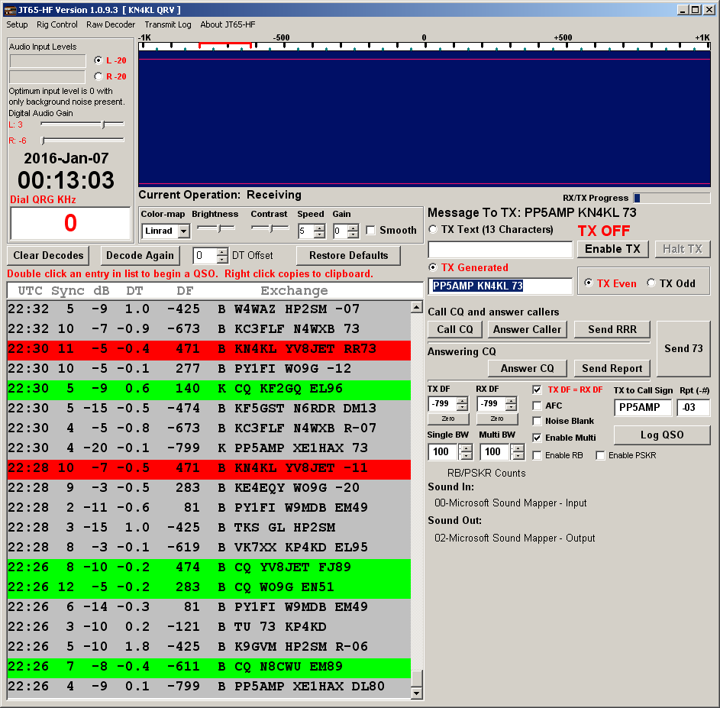
JT-65-HF
KN4KL SENDS 73 :31
YV8JET SENT COPY 73 :30
KN4KL SENT REPORT :29
YV8JET SENT REPORT :28
KN4KL SENT GRID :27
YV8JET CALLING CQ :26

Slide 16
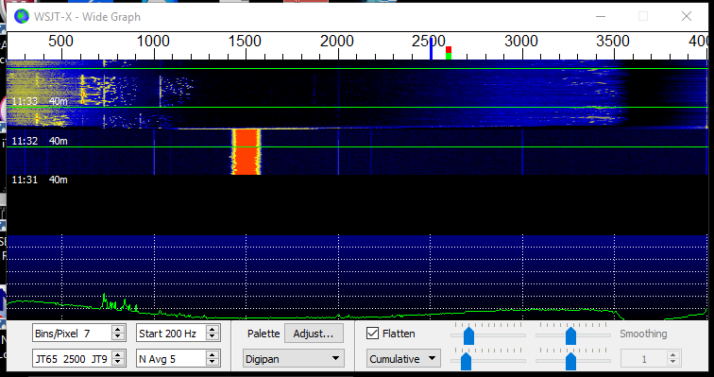
Waterfall with bandwidth on radio set too narrow. The top of the waterfall is after adjusting to 4 Khz

Slide 17
Fast computers are helpful when using JT65 but are not necessary. After the 47 second transmission the decoding starts. A fast computer will decode within a couple of seconds. This leaves about 10 seconds to decide which signal you want to reply to.
In order to decode JT9 and JT65 at the same time a dual core processor is necessary.

Slide 18
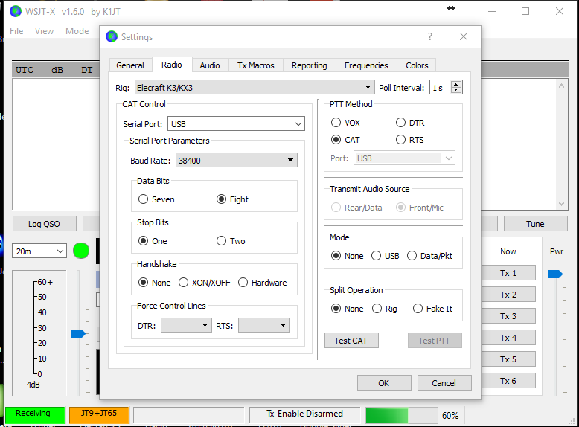
Notes:
SET UP INTERFACE

Slide 19
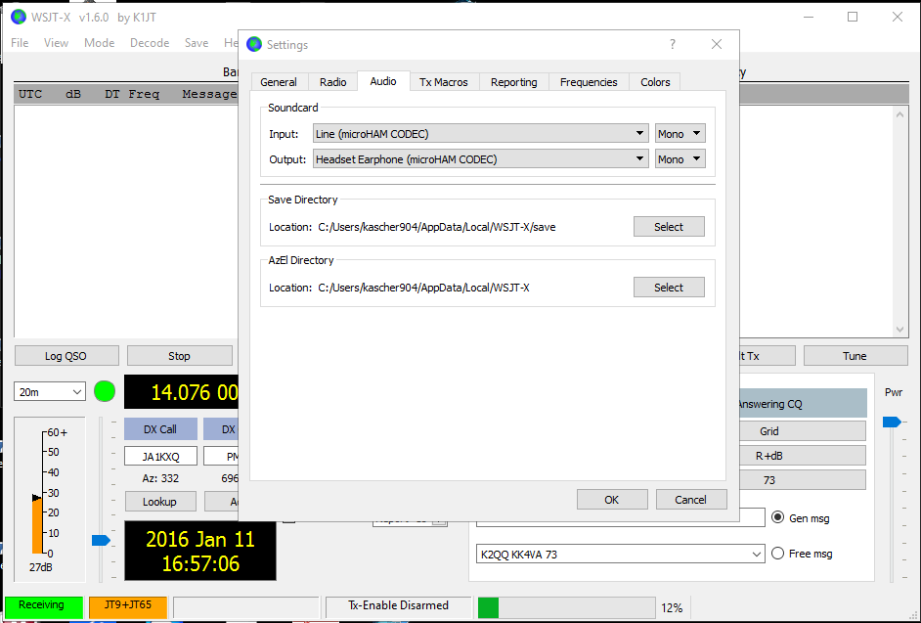
Notes:
SET UP SOUND CARD

Slide 20
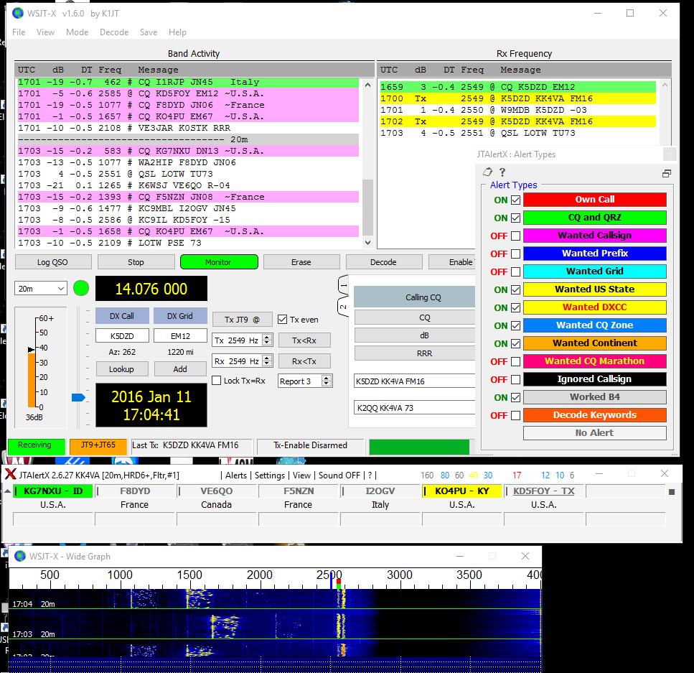
Notes:
JT ALERT COLOR CODES

Slide 21
Additional Information
For additional information on JT65, check out the documentation about JT65 Communications Protocol by Joe Taylor at the following location:
http://www.physics.princeton.edu/pulsar/K1JT/JT65.pdf

Slide 22

That’s ALL Folks!

